Slide 1

ORBITRON
Project Proposal
Tyler Kim’20
Kent School
Notes:
To use this title animation slide with a new image simply 1) move the top semi-transparent shape to the side, 2) delete placeholder image, 3) click on the picture icon to add a new picture, 4) Move semi-transparent shape back to original position, 5) Update text on slide.

Slide 2
“Vehicle with spherical wheels”
What is ORBITRON?
!
Just like in this SF movie ”I,robot”
The main objective of this project is
to pull out the potential and benefits
of spherical wheels, but approaching
it in a more realistic way.

Slide 3
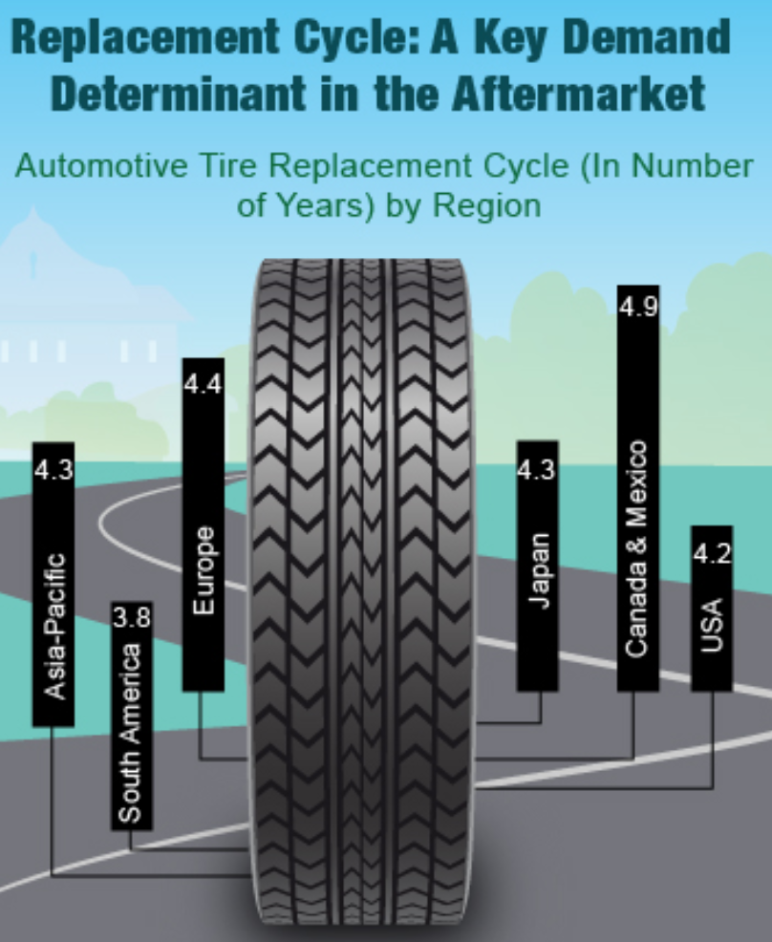
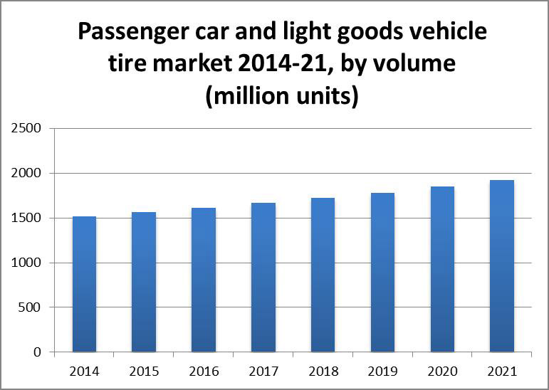
Market Analysis - World Tire Market

Slide 4
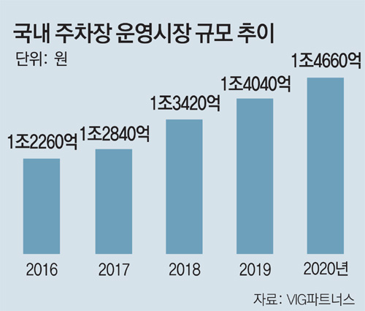
Market Analysis - South Korea’s Parking Lot System

Slide 5
Analysis of Prior Solution Examples
The Goodyear Tire – Eagle 360
Hankook Tire
KUKA omniMove
Magnetic Levitation
Mecanum Wheels
Ball-pin Tire
Unrealistic
Lot of energy required
Unstable in high speed
Vulnerable to bumpy terrains.
Cannot perform fluent movements

Slide 6
Video
Goodyear Eagle-360
Concept Video
Notes:
https://youtu.be/oSFYwDDVgac?t=1m25s

Slide 7
Benefits of Spherical Wheels presented by Goodyear
1
2
3
4
5
Larger contact area of the tire
Smooth, lateral vehicle movement
Changing directions without changing the actual driving direction.
Better control of
the vehicle in
wet/snowy
environment
Move as need to reduce slides on potential hazards
Reference :Goodyear’s Eagle-360 Tire concept
Notes:
Less wearness

Slide 8
1
In a wet environment(especially a water puddle), spherical shape will be able to push water side and reduce the probability of sliding.

Slide 9
2
Less space needed for
parking lots thanks to
tires that move in all
directions.

Slide 10
Justification I
Total Revolution of wheels, made by a student.
Taking Another Step
“Why should I+KENT care about this project?”
College Preparation
Engineering Experience
Bragging Rights

Slide 11
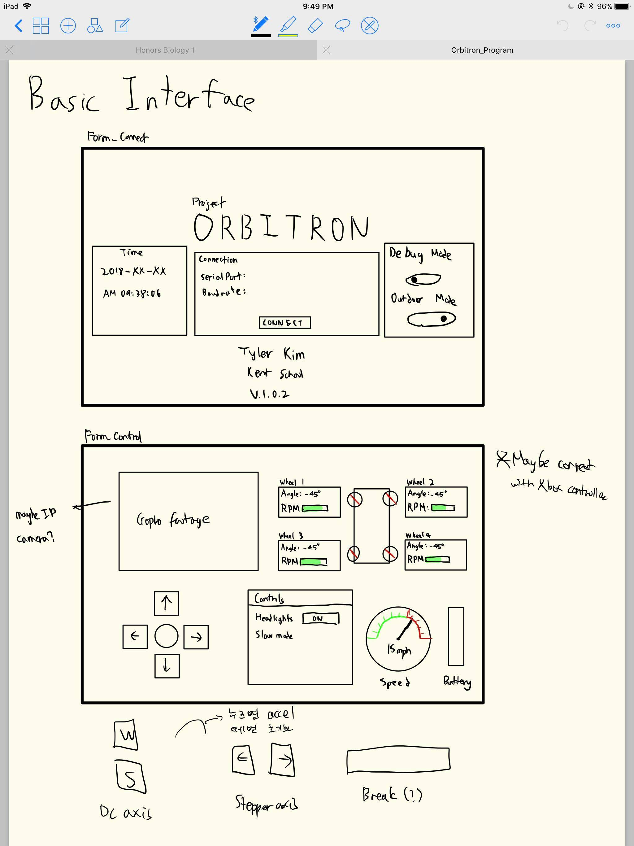
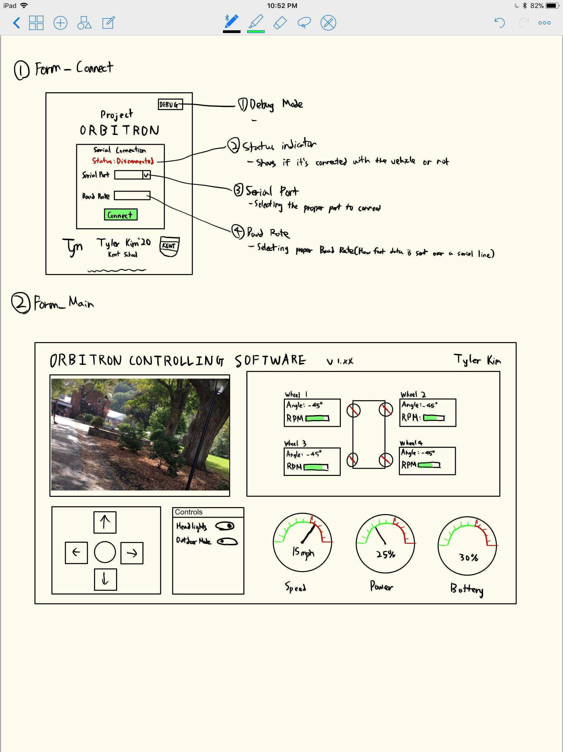
Orbitron Controlling Software using C#

Slide 12
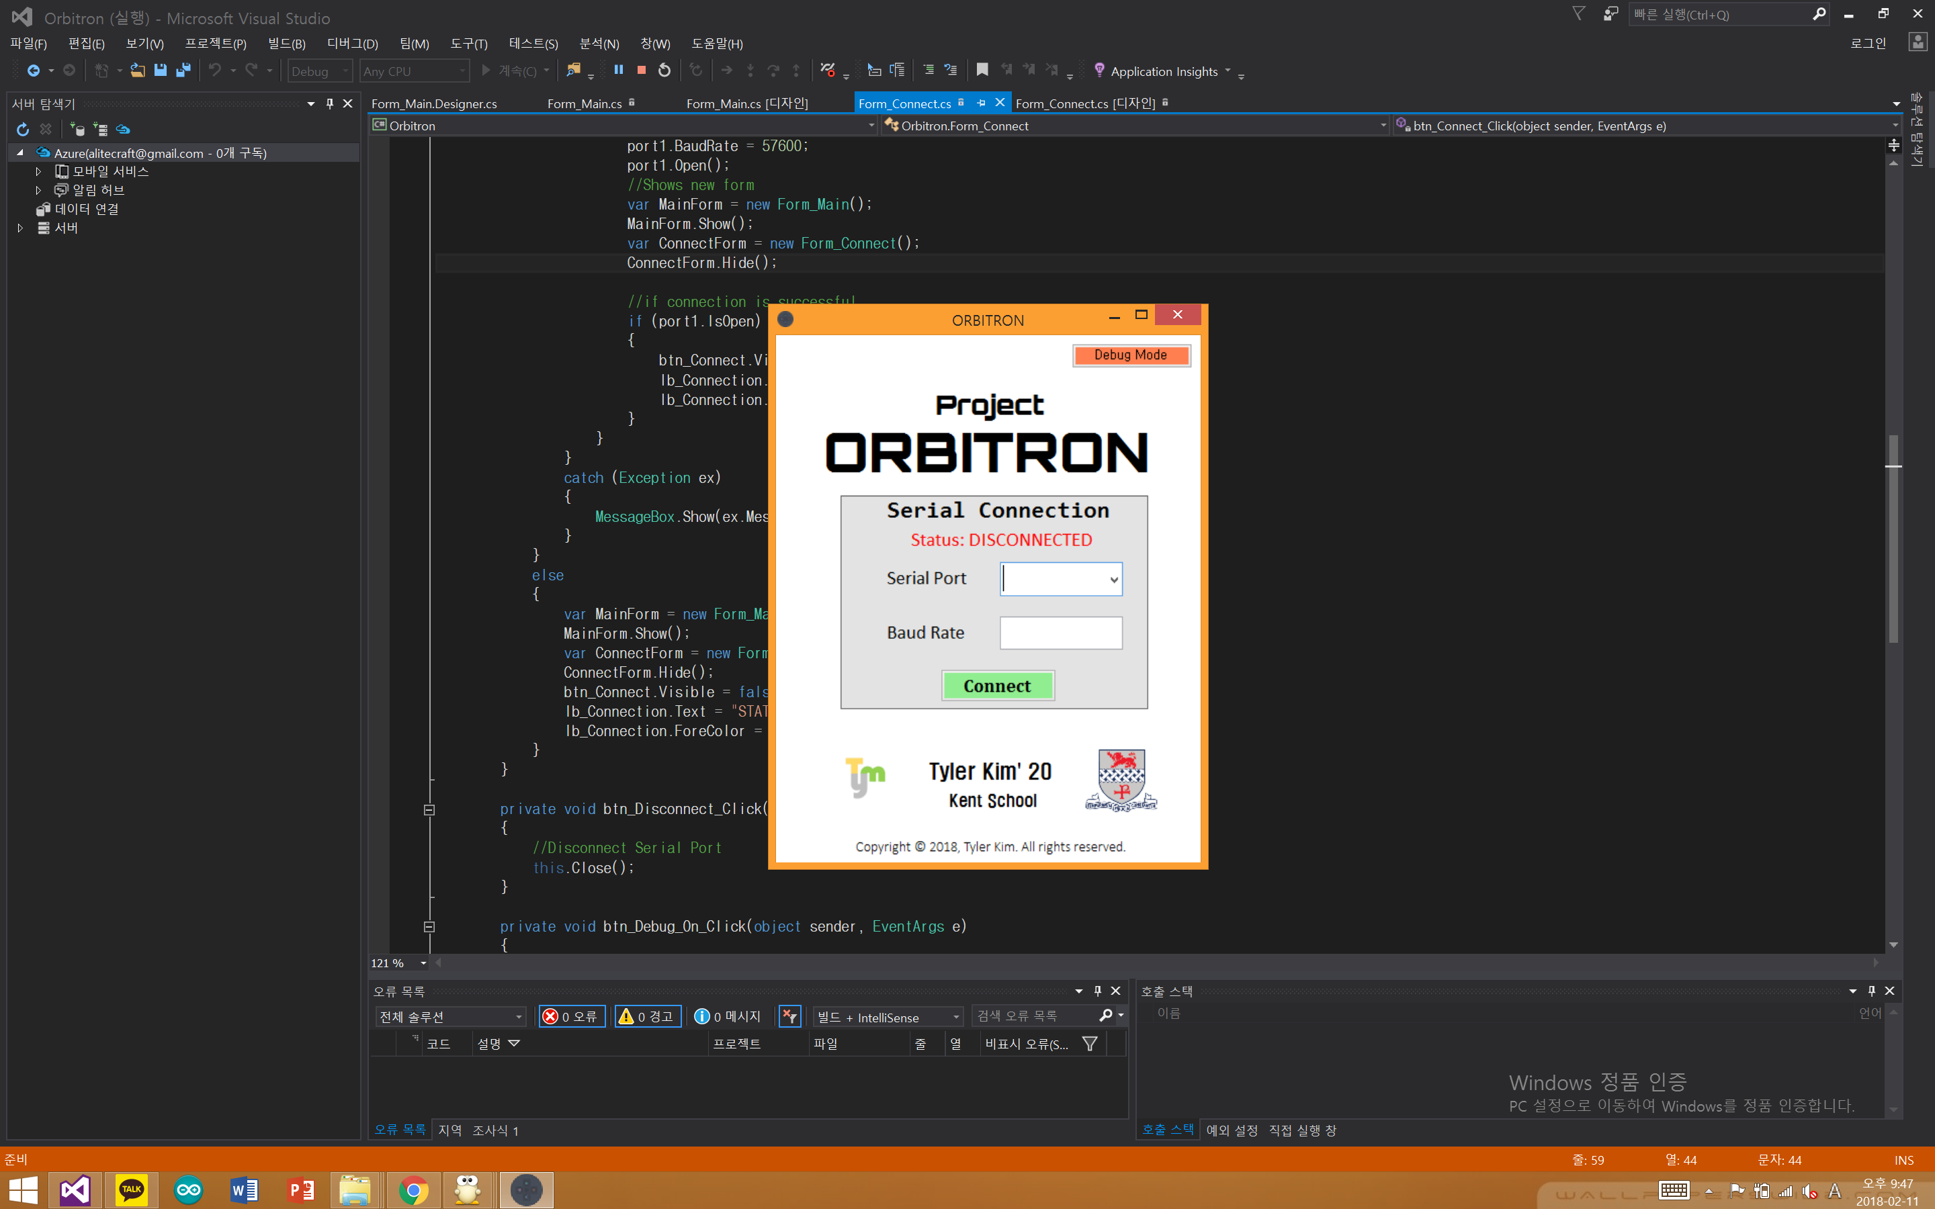

Slide 13
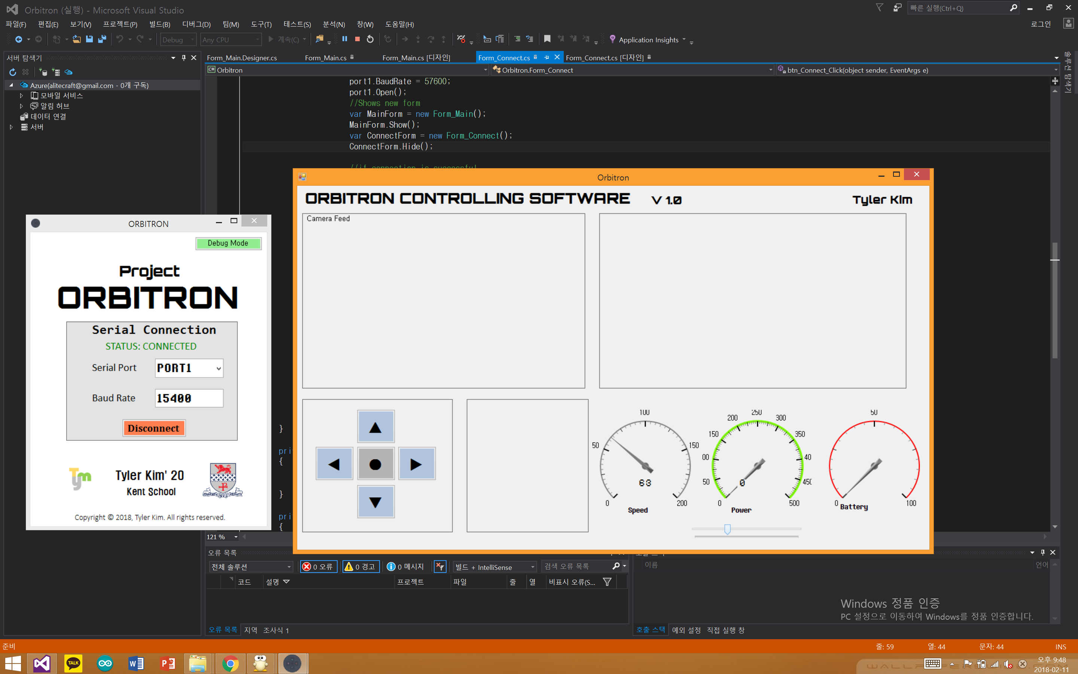

Slide 14
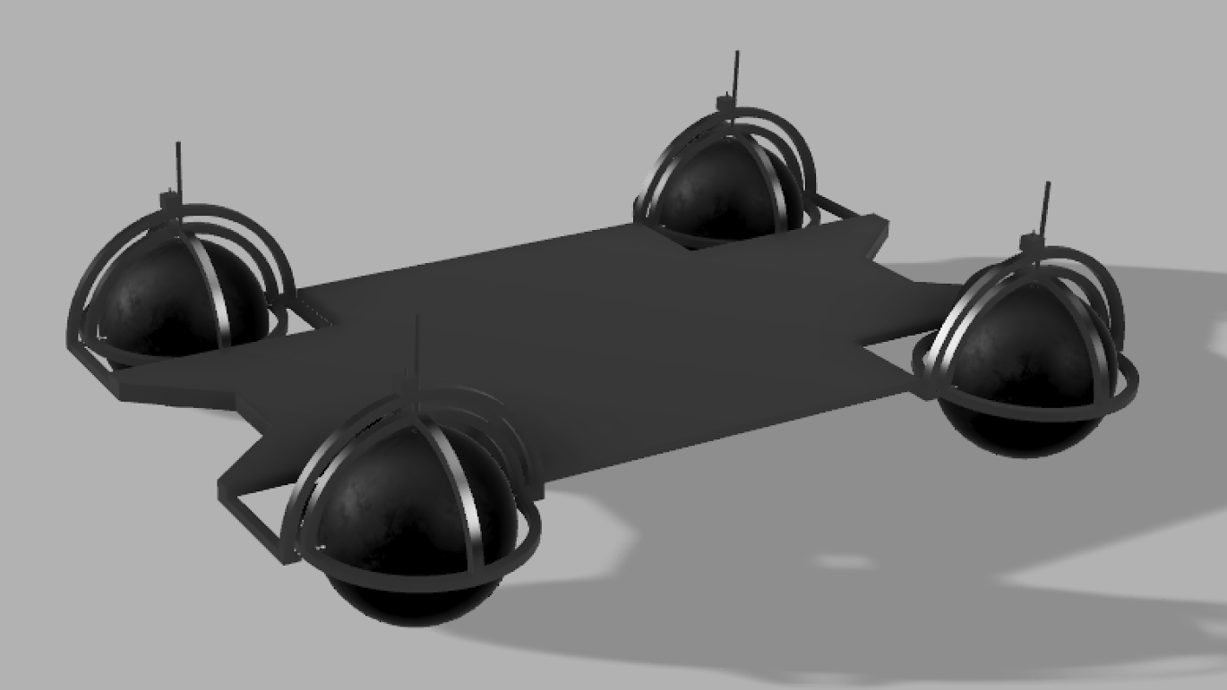
CAD Design #1
Orbitron_Car
The car’s base will be made out of black acrylic material, and the
Frame will be constructed with acrylic material as well, or lightweight metal.
Notes:
Tip:
When using complex image as full-bleed background add a transparency (70%-90%) fill layer to give contrast to text.

Slide 15
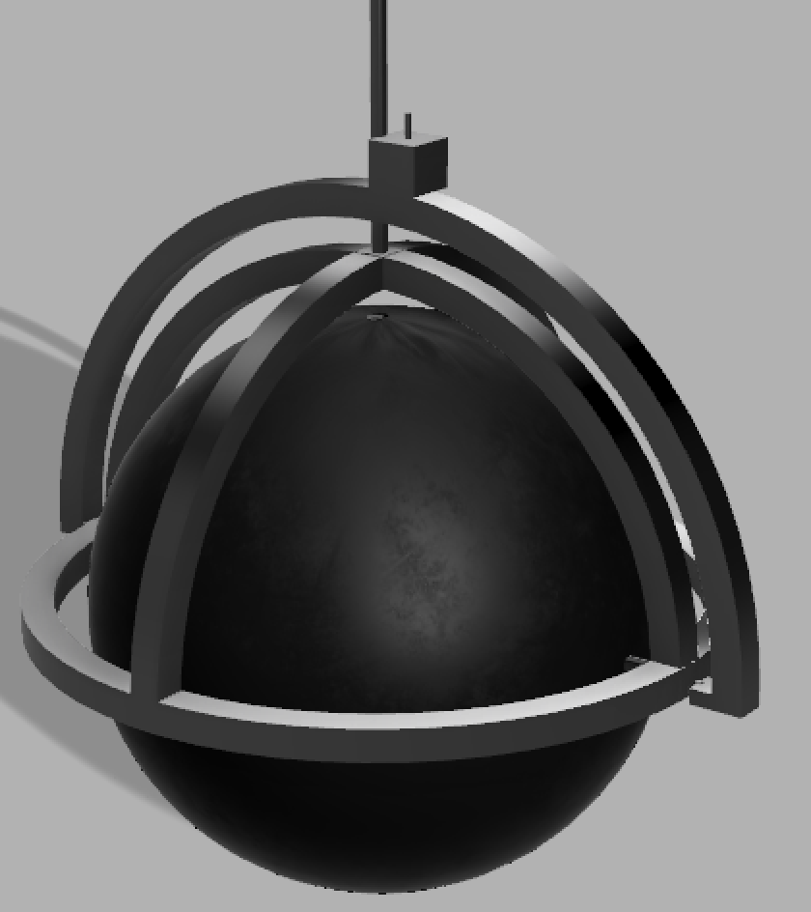
CAD Design #2
Orbitron_Wheel
There will be two separate axis of the wheel
allowing it to move in all directions
DC motor will be used to turn the actual wheel and stepper motors will be used for changing
the vertical axis

Slide 16
Finance
*(Star) means it is an approximated cost
# | Components | Price(USD)
1 | 4 Myo-Release Ball | 121.24
2 | Arduino Mega Board | 53.20
4 | Extra Arduino parts: Shields, Motor Drivers, XBee Components etc. | 200.00
5 | 4 High Torque Stepper Motors | 130.00
6 | 4 Right angle gearbox high-torque motors | 160.16
7 | Raw Materials(Wood, Metal etc) | *50.00
8 | Extra Electronic Parts | *30.00
 | Total Estimated Cost | *744.60
I expect the total cost will be around 700~800$

Slide 17

Thank You
CAD Design #2
For your consideration
Orbitron_Car
The wooden base of the car will be attached
on top of the metal base that is attatched with
the wheels
Tyler Kim
Notes:
Tip:
When using complex image as full-bleed background add a transparency (70%-90%) fill layer to give contrast to text.

